Slide 1
STAGES OF STATE FORMATION IN ANCIENT INDIA
TANUSHREE SANWAL
ASSISTANT PROFESSOR
KSOM

Slide 2
Six main stages
Six main stages in the history of ancient Indian polity can be identified.
The earliest stage was that of tribal military democracy in which tribal assemblies, which had some place for women were mainly pre-occupied with war.
The age of Rig Veda was primarily a period of assemblies.

Slide 3
second stage
It saw the break-up of the tribal polity.
Constant conflicts between the rājanyakshatriya and the ordinary businessman called the vis.
The chiefs were helped by the priesthood called the brahmins.
This stage saw the beginning of taxes and classes or varnas.

Slide 4
The third stage
It was marked by the formation of the full-fledged state.
There arose large territorial monarchies of Kosala and Magadha and tribal oligarchies in North-Western India and at the foot of the Himalayas.
For the first time we hear of large standing armies and organised machinery for the collection of land revenue

Slide 5
The fourth or the Maurya phase
It saw bureaucratic centralization based on the expanding economic activities of the state.
The state with the help of its bureaucracy controlled various aspects of the life of its subjects.

Slide 6
The fifth stage
It was marked by the process of decentralized administration in which towns, feudatories and military elements came to the forefront in both the Deccan and North India.
This was partly neutralized by the emphasis on the divinity of the king.

Slide 7
The last stage
It was identical with the Gupta period, may be called the period of proto-feudal polity.
Land grants now played an important part in the formation of the political structure
and those made by the Gupta feudatories conferred fiscal and administrative privileges on priestly beneficiaries.

Slide 8
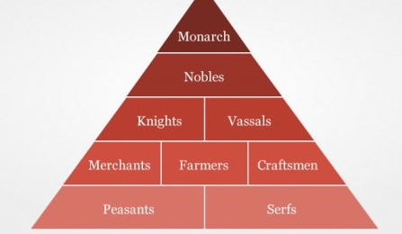
FEUDAL SYSTEM

Slide 9
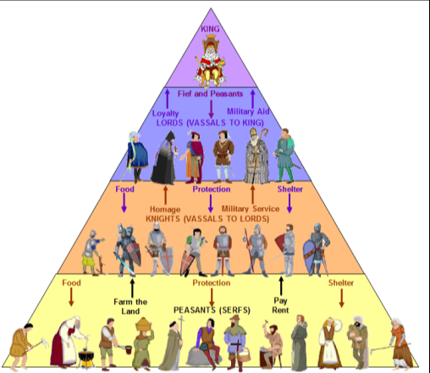

Slide 10
Feudalism
Medieval Age was the period from 600 AD to 1500 AD
Derived from the word ‘feud’, which means ‘conditional ownership of land’
Feudalism developed due to lack of a single central political authority as it had disintegrated into many small and big kingdoms.
Features
Land, not money, was the main source of power
Lack of a central political authority + numerous Feudal Lords controlled the affairs of the society + King was not very powerful.

Slide 11
Villages based economy
It was self-sufficient and produced little surplus for trade. The peasants worked on the land of the Feudal Lord & were exploited by the Feudal Lords.
‘Serfdom’ became an important feature of Feudalism. Whatever was produced on the Manor was consumed by the Lord and the inhabitants, while very little was traded.
[Serfs: they worked on the land of the Lord for free and had to perform all labour for him as he desired. They were not free and were tied to the land. This meant that their owners changed with the change in ownership of the land from one Lord to another. This system came to be known as Serfdom.]

Slide 12
Under the feudal contract, the lord had the duty to provide the fief for his vassal, to protect him, and to do him justice in his court. In return, the lord had the right to demand the services attached to the fief (military, judicial, administrative) and a right to various “incomes” known as feudal incidents.

